Slide 1
Sequence Modelling and Classification
Cheu Eng Yeow

Slide 2
Overview
Sequence Modelling and Classification
Triplet Loss Learning
Semi-hard Negative Triplets Selection
L2 Norm Embedding Network Architecture
Sequence Modelling using 2D Convolution Network
Non-Linear Triplet Associative-Contrastive Loss
L2 Norm Clamped Embedding Network Architecture
Marginally-hard Negative Triplets Selection
Results

Slide 3
Sequence Modelling and Classification
A sequence can be thought of as a list of elements with a particular order.
Examples:
A time series is a series of data points indexed in time order.
Text is a list of characters in order.
Video is a sequence of images.
To model and capture differentiating features in sequences so as to organise them into groups.

Slide 4
Representation of Time Series
Spectrogram of a signal
Image representation of multiple signals

Slide 5
Mapping Sequences to Euclidean Space
To directly learn a Euclidean embedding per sequence using a deep convolutional network.
Good embedding addresses,
Sequence verification (whether is of the same sequence); simply thresholding the distance between two embeddings
Sequence recognition (which is this sequence, classification); using simple classifier
Sequence clustering (find common sequences); using simple clustering algorithm

Slide 6
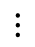
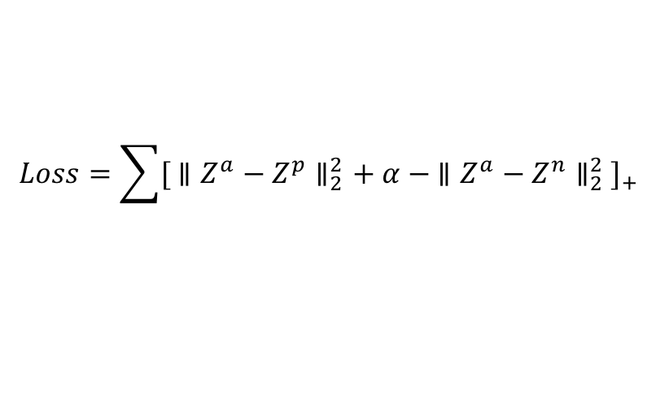
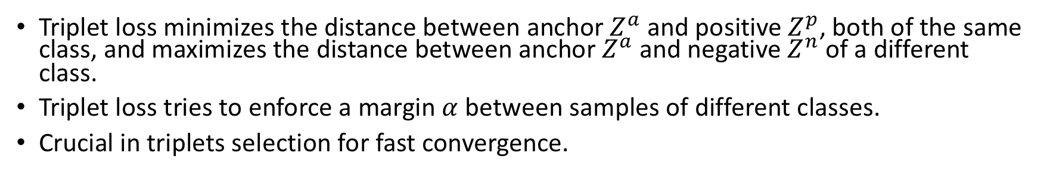
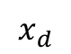
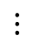
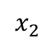
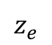
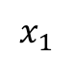
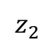
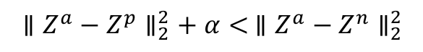
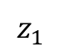
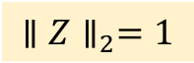
Triplet Loss Learning
Embedding Network
$$x_{1}$$
$$z_{1}$$
Triplet Loss Learning
$$x_{2}$$
$$z_{2}$$
$${∥Z^{a}−Z^{p}∥}_{2}^{2}+ α<{ ∥Z^{a}−Z^{n}∥}_{2}^{2}$$
$$⋮$$
$$⋮$$
$$Loss=\sum{{[ {∥Z^{a}−Z^{p}∥}_{2}^{2}+ α −{ ∥Z^{a}−Z^{n}∥}_{2}^{2} ]}_{+}}$$
$$x_{d}$$
$$z_{e}$$
Input space
Embedding space
$${∥Z∥}_{2}=1$$
Triplet loss minimizes the distance between anchor $Z^{a}$ and positive $Z^{p}$, both of the same class, and maximizes the distance between anchor $Z^{a}$and negative $Z^{n}$ of a different class.
Triplet loss tries to enforce a margin $α$ between samples of different classes.
Crucial in triplets selection for fast convergence.

Slide 7
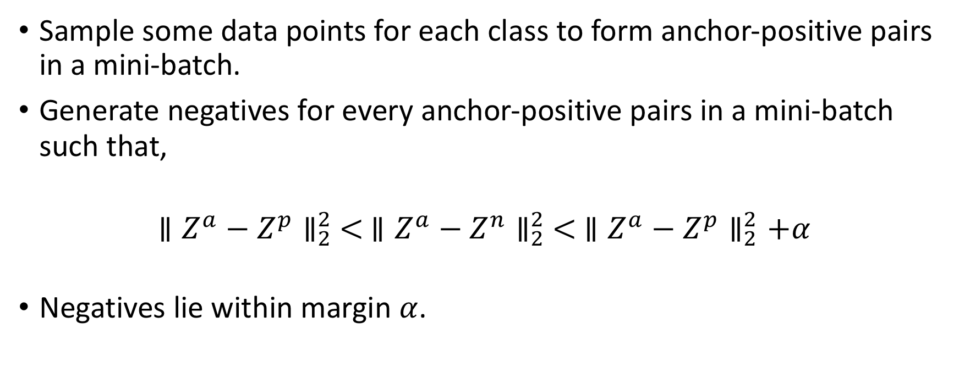
Semi-hard Negative Triplets Selection
Sample some data points for each class to form anchor-positive pairs in a mini-batch.
Generate negatives for every anchor-positive pairs in a mini-batch such that,
$${∥Z^{a}−Z^{p}∥}_{2}^{2} <{ ∥Z^{a}−Z^{n}∥}_{2}^{2} < {∥Z^{a}−Z^{p}∥}_{2}^{2}+α$$
Negatives lie within margin $α$.

Slide 8
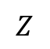
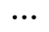
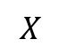
L2 Norm Embedding Network
Temporal 2D Convolution Network
Linear
SELU
Linear
BatchNorm1D
SELU
Linear
BatchNorm1D
SELU
Linear
L2 Norm
$$X$$
$$⋮$$
$$Z$$
Input
Embeddings
Convolution network follows by fully connected layers.
Magnitude of embedding vector is restricted to 1.

Slide 9
Sequence Modelling using 2D Convolution Network
Residual block (k, d)
Dropout
+
d =2
SELU
BatchNorm2D
WeightNorm
Dilated Conv2D
Output
Dropout
1 x 1 Conv2D
Signals
SELU
BatchNorm2D
Input
WeightNorm
Time
Dilated Conv2D
Dilated convolution residual block with kernel size k and dilation factors d.
Optional 1 x 1 convolution addition block for channel down sampling.
Output has the same height and width as the input.

Slide 10
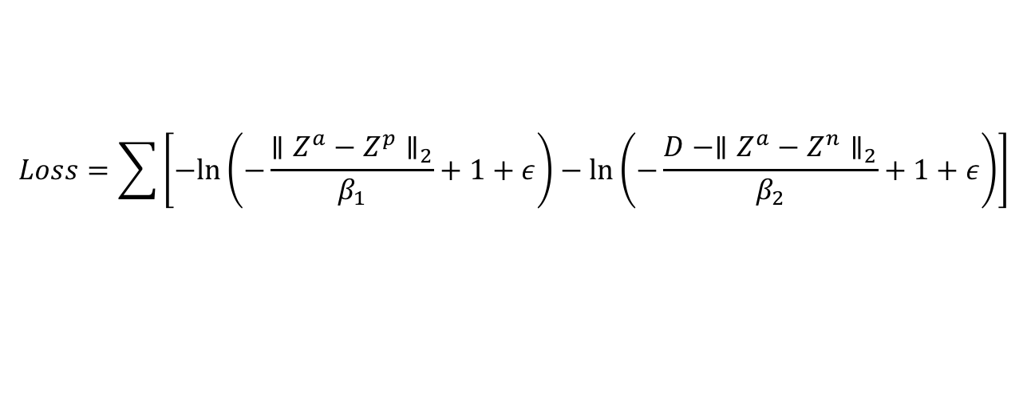
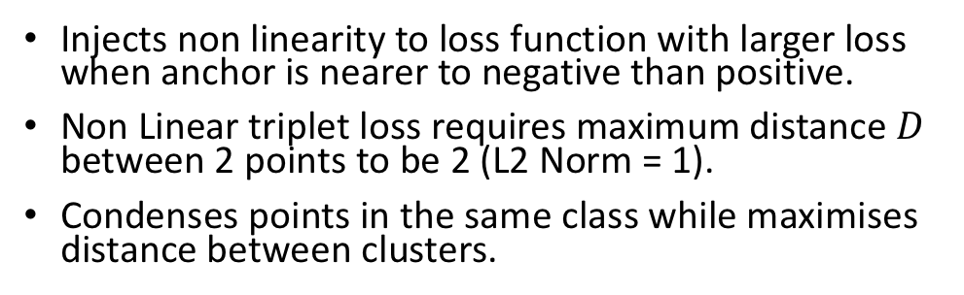
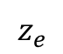
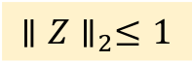
Non-Linear Triplet Associative-Contrastive Loss Learning
Embedding Network
$$x_{1}$$
$$z_{1}$$
Non-Linear Triplet Loss Learning
$$x_{2}$$
$$z_{2}$$
$$Loss=\sum{\left[−ln⁡\left(−\frac{{∥Z^{a}−Z^{p}∥}_{2}}{β_{1}}+1+ε\right)−ln⁡\left(−\frac{D −{∥Z^{a}−Z^{n}∥}_{2}}{β_{2}}+1+ε\right)\right]}$$
$$⋮$$
$$⋮$$
$$x_{d}$$
$$z_{e}$$
Input space
Embedding space
$${∥Z∥}_{2}≤1$$
Injects non linearity to loss function with larger loss when anchor is nearer to negative than positive.
Non Linear triplet loss requires maximum distance $D$ between 2 points to be 2 (L2 Norm = 1).
Condenses points in the same class while maximises distance between clusters.

Slide 11
L2 Norm Clamped Embedding Network
Temporal 2D Convolution Network
Linear
SELU
Linear
BatchNorm1D
SELU
Linear
BatchNorm1D
SELU
Linear
L2 Norm Clamp
$$X$$
$$⋮$$
$$Z$$
Input
Embeddings
Last layer allows points in embedding space to “cross”; faster convergence.

Slide 12
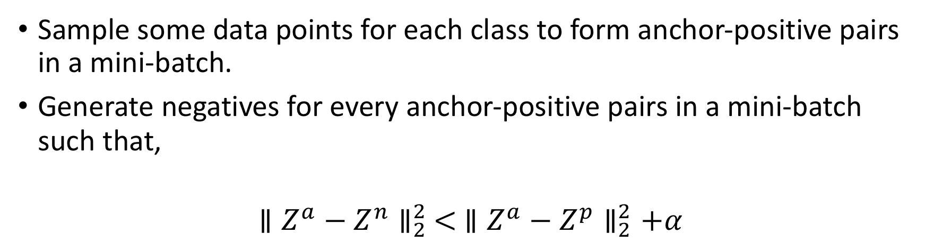
Marginally-hard Negative Triplets Selection
Sample some data points for each class to form anchor-positive pairs in a mini-batch.
Generate negatives for every anchor-positive pairs in a mini-batch such that,
$${ ∥Z^{a}−Z^{n}∥}_{2}^{2} < {∥Z^{a}−Z^{p}∥}_{2}^{2}+α$$

Slide 13
Experiment 1
Dummy dataset with 2 classes

Slide 14
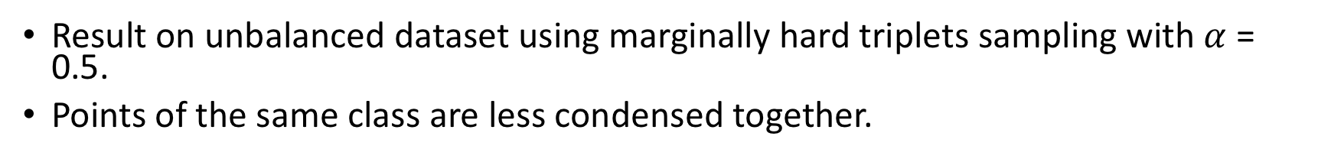
Linear Triplet Loss Norm Embedding
Before training
After 50 epochs
After 500 epochs
After 1000 epochs
Result on unbalanced dataset using marginally hard triplets sampling with $α$ = 0.5.
Points of the same class are less condensed together.

Slide 15
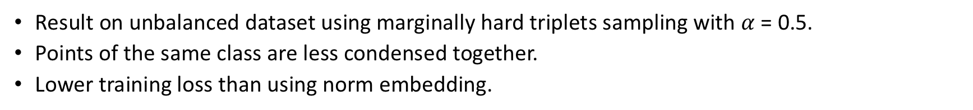
Linear Triplet Loss Norm Clamped Embedding
Before training
After 50 epochs
After 500 epochs
After 1000 epochs
Result on unbalanced dataset using marginally hard triplets sampling with $α$ = 0.5.
Points of the same class are less condensed together.
Lower training loss than using norm embedding.

Slide 16
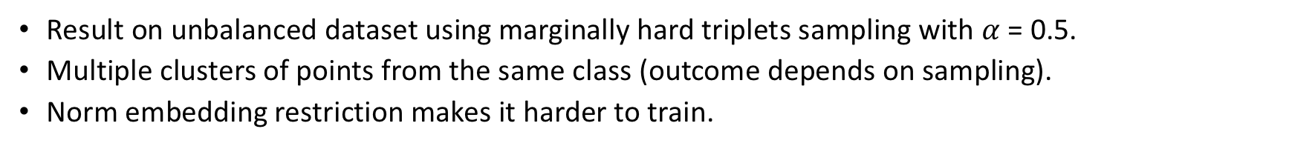
Non-Linear Loss Norm Embedding
Before training
After 50 epochs
After 500 epochs
After 1000 epochs
Result on unbalanced dataset using marginally hard triplets sampling with $α$ = 0.5.
Multiple clusters of points from the same class (outcome depends on sampling).
Norm embedding restriction makes it harder to train.

Slide 17
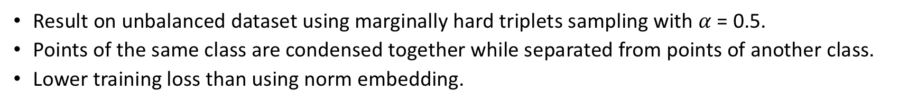
Non-Linear Loss Norm Clamped Embedding
Before training
After 50 epochs
After 500 epochs
After 1000 epochs
Result on unbalanced dataset using marginally hard triplets sampling with $α$ = 0.5.
Points of the same class are condensed together while separated from points of another class.
Lower training loss than using norm embedding.

Slide 18
Experiment 2
Dummy dataset with 10 classes

Slide 19
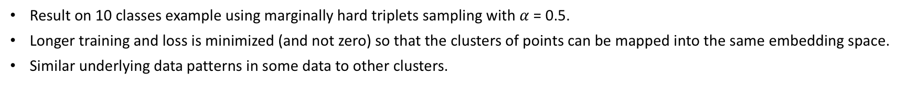
Non-Linear Loss Norm Clamped Embedding
Before training
After 50 epochs
After 1000 epochs
After 5000 epochs
Result on 10 classes example using marginally hard triplets sampling with $α$ = 0.5.
Longer training and loss is minimized (and not zero) so that the clusters of points can be mapped into the same embedding space.
Similar underlying data patterns in some data to other clusters.

